Slide 1


High-Accuracy Smoke and Fire Detection
Presenter: Anudeep, Student, MGIT
Guide: Dr. Barnali, Associate Professor, MGIT
Date: 14-12-2024
Paper ID: 197

Slide 2
PROBLEM STATEMENT
Fire and smoke incidents in forests and industrial areas pose serious risks to the environment and public safety, requiring early and accurate detection systems.
Existing methods, such as thermal sensors and basic image-based systems, often suffer from high false-positive rates and poor performance under challenging environmental conditions.
This project aims to develop a deep learning-based detection system using CNNs with Efficient Channel Attention (ECA) layers to enhance accuracy, reduce false alarms, and provide reliable real-time detection.

Slide 3
INTRODUCTION
Fire and Smoke incidents can cause significant damage to properties and endanger the lives of people.
Therefore, it is essential to have an efficient fire detection system in place to prevent or minimize the damage caused by fire. Smoke and fire detection systems are commonly used in commercial and residential buildings to detect the presence of smoke and fire and alert the occupants or the authorities.
A smoke and fire detection system can be developed using a Convolutional Neural Network(CNN), which is a deep learning architecture that has shown promising results in computer vision tasks such as image recognition.

Slide 4
MOTIVATION
Fire and smoke incidents are critical events that can lead to severe injuries and substantial property damage. According to data from the National Crime Records Bureau (NCRB) of India, fire accidents are a significant concern:
Incident Statistics: In India, there were approximately 2,70,000 fire incidents reported in 2023 alone, resulting in numerous casualties and extensive property damage.
Human Impact: These incidents led to significant loss of life, with thousands of civilian fatalities and injuries reported across the country.
Economic Impact: The direct property loss from these incidents amounted to billions of rupees, impacting businesses, homes, and public infrastructure.

Slide 5
EXISTING SYSTEM
Sensor-Based Detection
Technologies: Optical and ionization smoke detectors.
Limitations:
Slow Response: Detect fire only after smoke/heat reaches sensors.
False Alarms: Triggered by dust, steam, or environmental factors.
Outdoor Limitations: Ineffective in large, open areas like forests.
High Maintenance: Frequent calibration and upkeep required.

Slide 6
PROPOSED SYSTEM
Deep Learning-Based Fire and Smoke Detection
Technologies: Convolutional Neural Network (CNN) with Efficient Channel Attention (ECA) layers, Real-time Inference, Data Augmentation.
Advantages:
High Accuracy: Achieves 98.7% average test accuracy, reducing false positives.
Real-Time Detection: Operates at 30 frames per second, making it suitable for immediate fire detection.
Enhanced Generalization: Data augmentation techniques improve model performance and reduce overfitting.
Scalable and Versatile: Can be deployed in both indoor and outdoor environments, such as forests and industrial settings.
Reduced Maintenance: No need for frequent calibration, unlike traditional sensors.
Outcome: A more reliable, efficient, and scalable solution for early fire detection, offering real-time alerts for improved public safety.

Slide 7
Literature Survey
Reference | Publisher | Technique | Description
Smoke and Fire Detection | International Journal of Scientific and Research Publications, Volume 4, Issue 7, July 2024 | Image Processing | Focuses on fire and smoke detection through image segmentation. The system detects smoke first, then fire, using color and light parameters of flames to trigger alarms based on increasing flame area in video frames.
Enhancing Fire and Smoke Detection Using Deep Learning Techniques | 2nd Computing Congress 2023, SRM Institute of Science and Technology | Deep Learning | This paper discusses advancements in real-time deep learning algorithms for fire and smoke detection, highlighting the effectiveness of image-based detection over traditional sensors in real-world applications.
An Improved Fire Detection Approach Based on YOLO-v8 for Smart Cities | Neural Computing and Applications (2023) | Deep Learning | Proposes an improved fire detection system for smart cities using YOLOv8, enhancing fire detection accuracy and reducing false alarms with deep learning in real-time applications.
Real-time Fire Detection Algorithms Running on Small Embedded Devices Based on MobileNetV3 and YOLOv4 | Fire Ecology (2023) | Deep Learning | Focuses on fire detection on small embedded devices using YOLOv4 and MobileNetV3. The approach enhances real-time performance and accuracy while maintaining low computational cost for small devices.
A Fire and Smoke Detection Model Based on YOLOv8 Improvement | International Journal of Advanced Computer Science and Applications (2024) | Deep Learning | Discusses an improved YOLOv8 model for fire and smoke detection with a lightweight architecture and enhanced attention mechanism for better performance and reduced model size.

Slide 8
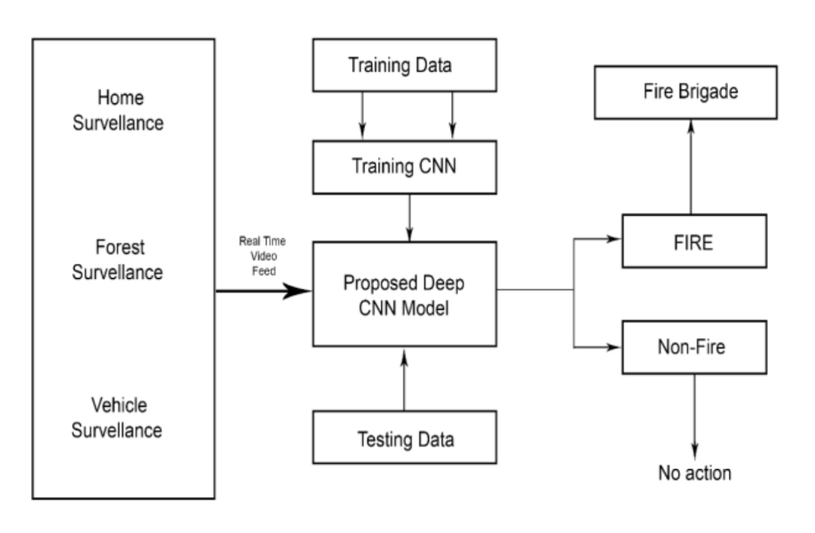
SYSTEM DESIGN

Slide 9
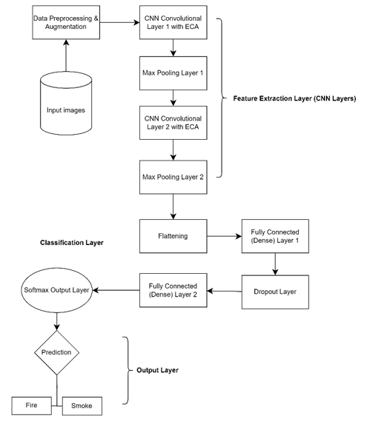

Slide 10
Technical Specifications
Software Requirements:
Operating System (OS): Windows, Linux, or macOS
Frameworks: TensorFlow, Keras, OpenCV, NumPy, Matplotlib
Tools: Python 3.x, Jupyter Notebook, CUDA (for GPU acceleration)
Hardware Requirements:
Processor: Intel i5/i7 or AMD Ryzen 5/7 (or equivalent)
RAM: Minimum 8 GB (16 GB recommended for faster processing)
GPU: NVIDIA GTX 1060 or higher (for model training and real-time detection)
Storage: Minimum 256 GB SSD (for faster read/write speeds)

Slide 11
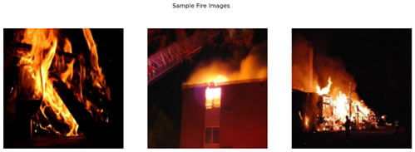
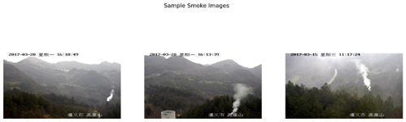
DATASET
I used a labeled dataset of forest fire and smoke images acquired from Kaggle, with the images categorized into two classes: "fire" and "smoke."

Slide 12
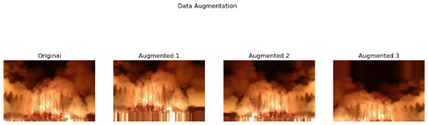
METHODOLOGY
Data Augmentation :
Data augmentation was used for the generalization of the model with prevention of overfitting.

Slide 13
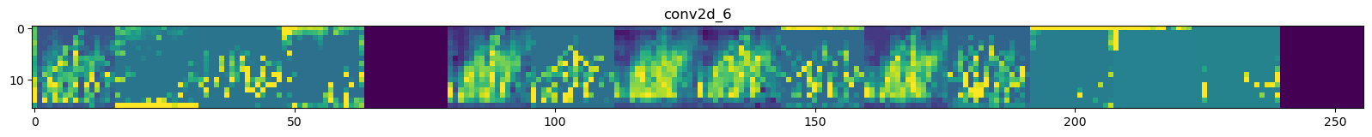
CNN Architecture - Feature Map Visualization
visualizes the feature maps (activations) of a Convolutional Neural Network (CNN) for a given input image.

Slide 14
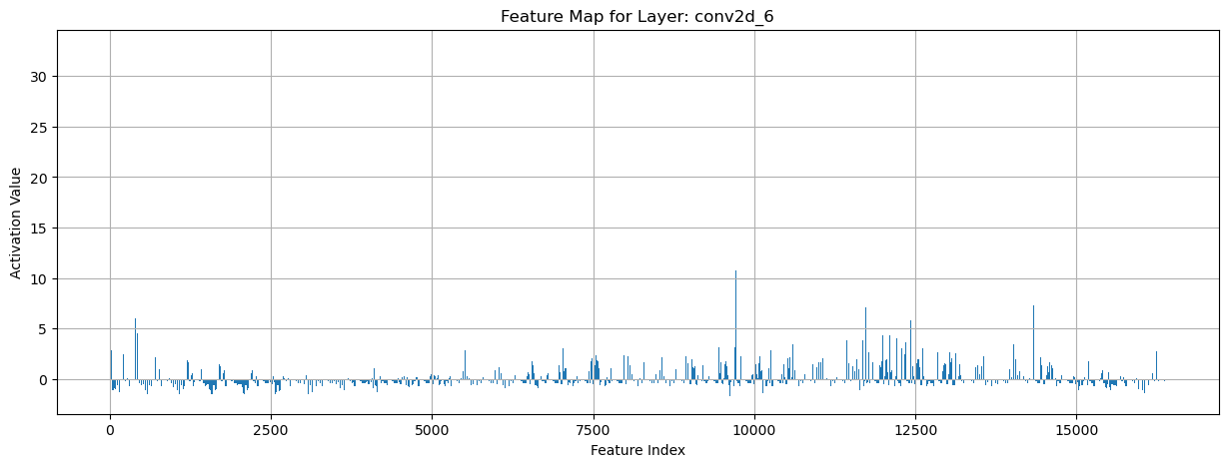
Model training and optimization
The proposed model was trained with the Adam optimizer, using binary cross-entropy loss. The training is done over 10 epochs with a batch size of 16. A model checkpoint is utilised to save the best-performing model according to validation loss, where the model that has the best performance in validation loss will be stored. It visualizes a feature map for the understanding of the learning process of the convolutional layers. Visualization helps to understand that how the patterns of smoke and fire are being interpreted by the model.

Slide 15
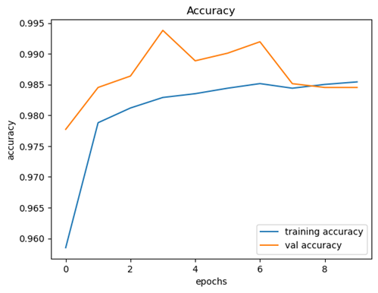
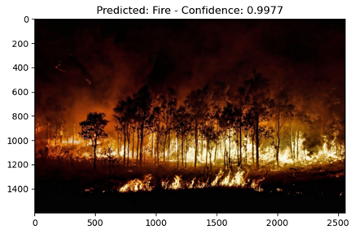
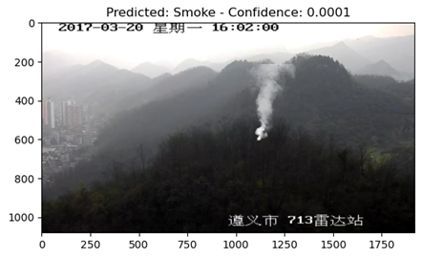
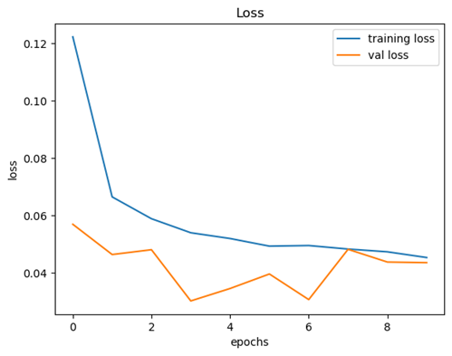
RESULTS

Slide 16
CONCLUSION
The paper presents a fire and smoke detection system using Convolutional Neural Networks (CNN) with Efficient Channel Attention (ECA) layers.
The model was trained on a Kaggle dataset, achieving:
98.54% training accuracy
99.20% validation accuracy
98.7% average test accuracy
Data augmentation techniques (horizontal flips, zoom, shifting) enhanced generalization and reduced false positives.
Results highlight the effectiveness of deep learning for accurate fire detection, aiding early alerts for public safety.

Slide 17
FUTURE SCOPE
Enhanced Detection Capabilities
Incorporate gas leak detection and thermal imaging for low-visibility environments.
Improved Model Accuracy
Use larger datasets and advanced neural networks for better accuracy and real-time performance.
Scalability and Deployment
Enable cloud-based, scalable systems for large environments and mobile monitoring.
Reduction of False Alarms
Apply AI-powered predictive models to reduce false positives and increase reliability.

Slide 18
REFERENCES
Gharge, S., Birla, S., Pandey, S., Dargad, R., & Pandita, R. (2014). Smoke and Fire Detection. International Journal of Scientific and Research Publications, 4(7), 1-5. ISSN 2250-3153.
Chitram, S., Kumar, S., & Thenmalar, S. (2023). Enhancing Fire and Smoke Detection Using Deep Learning Techniques. Proceedings of the 2nd Computing Congress 2023, SRM Institute of Science and Technology, Chennai, India, 28–29 December 2023.
Talaat, F. M., & ZainEldin, H. (2023). An Improved Fire Detection Approach Based on YOLO-v8 for Smart Cities. Neural Computing and Applications, 35, 20939-20954. https://doi.org/10.1007/s00521-023-08809-1
Zheng, H., Duan, J., Dong, Y., & Liu, Y. (2023). Real-time Fire Detection Algorithms Running on Small Embedded Devices Based on MobileNetV3 and YOLOv4. Fire Ecology, https://doi.org/10.1186/s42408-023-00189-0
Gao, P. (2024). A Fire and Smoke Detection Model Based on YOLOv8 Improvement. International Journal of Advanced Computer Science and Applications, 15(3).

Slide 19
Thank you...

